Slide 1


PROJECT REPORT
ON
MICRO CREDIT LOAN DEFAULTER
SUBMITTED BY
NIMESH KUMAR ROY

Slide 2
SOMETHING ABOUT THE TOPIC
What is Microcredit?
Microcredit is an extremely small loan given to those who lack a steady source of income, collateral, or any credit history. It aims to support and kickstart entrepreneurs who are unable to obtain the financial backing needed to start a small business or capitalize on an idea.
Microcredit is also part of microfinance, a line of finance that aims to help people of a lower socioeconomic background through catered financial services, which include savings accounts and loans.
How does Microcredit Work?
Microcredit was built on the concept that people with skills and more entrepreneurial mindsets also came from impoverished countries that did not necessarily have access to financial services that could suit them.
People who receive microcredit services typically live on a barter system, where goods or services are exchanged for other goods or services, and currency is not used as a medium for exchange.
Cons of Microcredit
There are some cons regarding microcredit, including too much pressure to repay loans, a large suicide rate among borrowers, and severe debt levels.
A contributing factor to the disadvantages is the high interest rates on some microcredit loans – rates can be 30% or even higher. Some even compare microcredit loans to loan sharks or NINJA loans, which actively take advantage of impoverished individuals.

Slide 3
THE PROBLEM
(1) MFI to provide micro-credit on mobile balances to be paid back in 5 days. The Consumer is believed to be defaulter if he deviates from the path of paying back the loaned amount within the time duration of 5 days.
(2) For the loan amount of 5 (in Indonesian Rupiah), payback amount should be 6 (in Indonesian Rupiah), while, for the loan amount of 10 (in Indonesian Rupiah), the payback amount should be 12 (in Indonesian Rupiah).
(3) The sample data is provided to us from our client database. It is hereby given to you for this exercise. In order to improve the selection of customers for the credit, the client wants some predictions that could help them in further investment and improvement in selection of customers.
(4) So here we will build a model using classification technique which can be used to predict in terms of a probability for each loan transaction, whether the customer will be paying back the loaned amount within 5 days of issuance of loan. In this case, Label ‘1’ indicates that the loan has been payed i.e. Non- defaulter, while, Label ‘0’ indicates that the loan has not been payed i.e. defaulter.

Slide 4
The data is in .csv format .
The data have 209593 rows × 37 columns .
The data have dtypes: float64(21), int64(12), object(3)
The data have “No Null Values” .
The data have one duplicate row.
The data have one “DATE” column and one “MOBILE NO.” column.
Column “pcircle” has only one unique value.
Numerical Features Count 33
Discrete feature Count 4
Continuous feature Count 29
Categorical feature Count 3
THE DATA OVERVIEW

Slide 5
STEPS FOR DATA IMPUTATION
It will tells about data shape & data types.
If any present then take appropriate action.
If found then drop the duplicate rows.
It gives information about mean,median
mode, min,max and outliers .
It gives us the info how much features are related to
each other and also if any multicolinearity is present. We deleted the columns daily_decr30','rental30','amnt_loans30','payback30 because these columns create multicolinearity .
Extract the pdate column in day,month,year
to check the relation with target column.
Delete the column “pcircle” as it has only one unique value.
CHECK THE DATA INFO
CHECK NULL VALUES
CHECK DUPLICATE VALUES
STATISTICAL INFO
CHECK CORRELATION
EXTRACTION

Slide 6
Plot correlation matrix via heatmap to see the correlation of the columns with other columns.
Also visualize the correlation of columns with target column via bar graph to see which column is highly correlated with target column.
See the number of defaulter and non defaulter customers with the help of count plot.
Plot histogram to displays the shape and spread of continuous sample data.
See the customers labels i.e defaluter/Non-defaulter according to date and month with count plot.
Also see the distribution of the data with the help of distribution plot whether it is left skewed or right skewed.
DATA VISUALIZATION

Slide 7
J
As we know the target variable and dataset is imbalanced first we used SMOTE Technique to balance the target variable and we don’t too much focus on accuracy score . We see the precision and recall value along with f1_score.
This is classification problem so we use accuracy score, classification report and confusion matrix as our evaluation matrix. We also see the AUC score and also plot the AUC_ROC curve for our final model.
We use the following model-
Logistic Regression.
Decision Tree Classifier.
Random Forest Classifier.
KNeighbor Classifier
Naive Bayes Classifier
Support Vector Classifier
XGBoost Classifier
MODEL SELECTION

Slide 8

RESULTS WE GET

Slide 9
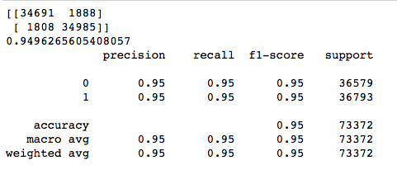
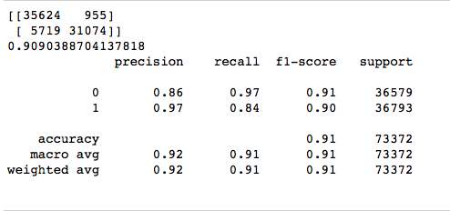
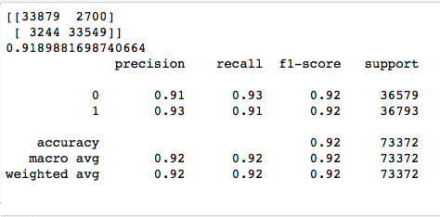
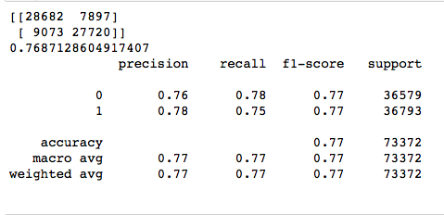
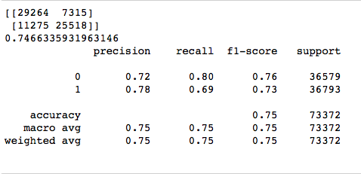
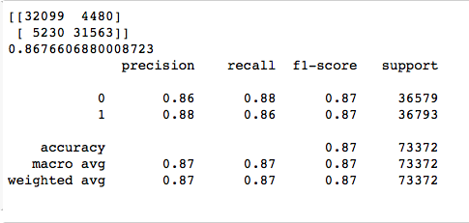
Random Forest Classifier
KNeighbor Classifier
Decision Tree Classifier
Logistic Regression
Naive Bayes Classifier
Support Vector Classifier

Slide 10
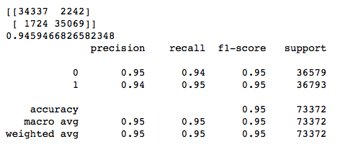
XGBoost Classifier

Slide 11
Conclusion
Random Forest Model and XGBoost Model both are working well on dataset.Both are predecting 94% correct result.

